Slide 2
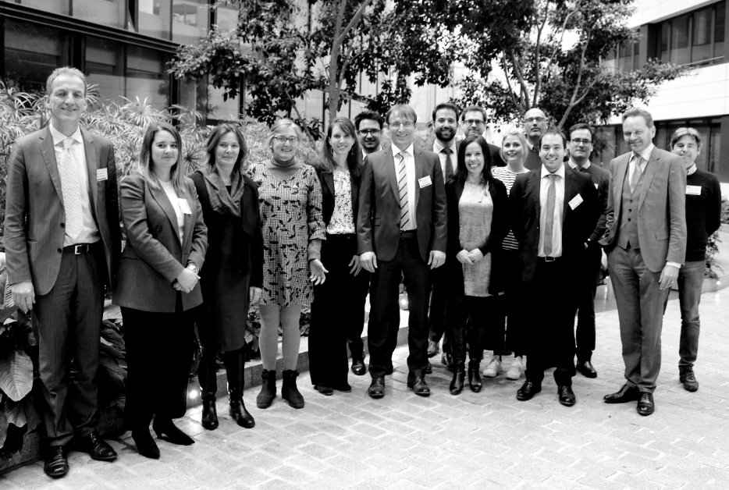
European IP Helpdesk
Service initiative of the European Commission providing free-of-charge first-line support on IP-related issues
Helping current and potential beneficiaries of EU-funded projects, researchers and EU SMEs engaged in cross-border business manage their intangible assets
www.iprhelpdesk.eu

Slide 3

European IP Helpdesk Team
EURICE GmbH (Coordinator)
University of Alicante
University of Navarra
TUM-Tech GmbH

Slide 4

Philosophy
From providing IPR information to practical IP capacity building and IP-asset management
Solution-oriented & hands-on
Large pool of IP experts in various thematic fields
Target-group specific services

Slide 5











Services
Website
Ambassadors
Training
Events
Publications
Helpline

Slide 6

Website
Central information hub
Regular updates on European IP Helpdesk news, events, publications
Online registration for helpline, free webinars, newsletter, contact forms

Slide 7

Publications
Online library: fact sheets, case studies, IP guides and charts, infographics, templates, FAQs
IP Specials: information packages on “hot” IP & innovation topics
Bulletin: thematic online magazine published twice a year
Bi-weekly newsletter

Slide 8

Helpline
Free of charge first-line IP support
Personal and “to the point”
Answer within 3 working days
Email, phone and web
In: English, Spanish, French, German, Italian and Polish
Confidential

Slide 9

Training
Online and on-site
Focus: Practical aspects of IP use and management
Enabling: helping our target audiences build their own capacities
Involving: collaboration with external experts and stakeholders

Slide 10

Stakeholder Cooperation
Fostering synergies with organisations involved in IP and innovation throughout Europe
Liaising with European business and research stakeholders/ initiatives/associations
Networking via LinkedIn and Twitter

Slide 11

Ambassadors
Cooperation scheme with the Enterprise Europe Network (EEN): 50 ambassadors – 29 countries
Building IP capacities among European SMEs
Exchange and feedback from ambassadors on needs of SMEs
Local awareness and training events

Slide 12




International IPR SME Helpdesks
www.ipr-hub.eu

Slide 13

Contact us!
www.iprhelpdesk.eu
service@iprhelpdesk.eu
Twitter @iprhelpdesk
LinkedIn /european-ipr-helpdesk

Slide 14
Thank You!
DISCLAIMER
The European IP Helpdesk provides free-of-charge first-line support on IP-related issues aiming to help current and potential beneficiaries of EU-funded projects, as well as EU SMEs, manage their Intellectual Property assets.
The European IP Helpdesk is managed by the European Commission’s Executive Agency for Small and Medium-sized Enterprises (EASME), with policy guidance provided by the European Commission’s Directorate-General for Internal Market, Industry, Entrepreneurship and SMEs (DG Grow).
The information provided by the European Union IP Helpdesk is not of a legal or advisory nature and no responsibility is accepted for the results of any actions made on its basis. Moreover, it cannot be considered as the official position of EASME or the European Commission. Neither EASME nor the European Commission nor any person acting on behalf of EASME or of the European Commission is responsible for the use which might be made of this information.
© European Union (2019)

